Slide 1
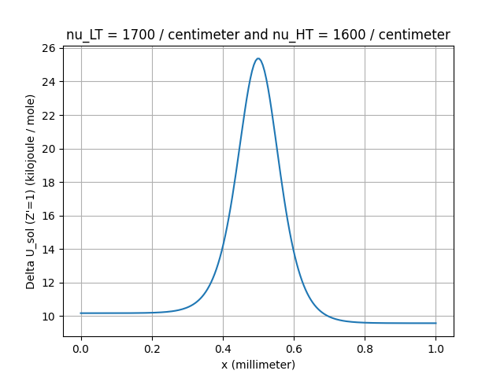
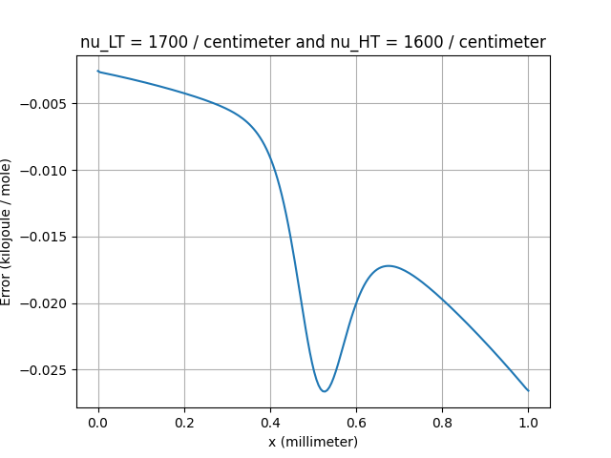
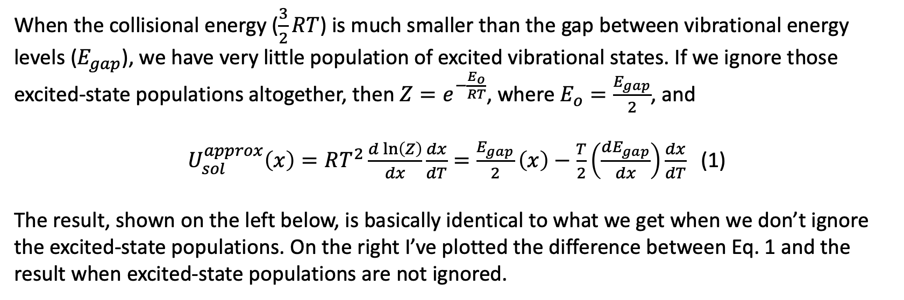


When the collisional energy ($\frac{3}{2}RT$) is much smaller than the gap between vibrational energy levels ($E_{gap}$), we have very little population of excited vibrational states. If we ignore those excited-state populations altogether, then $Z=e^{−\frac{E_{o}}{RT}}$, where $E_{o}=\frac{E_{gap}}{2}$, and
$U_{sol}^{approx}\left(x\right)=RT^{2}\frac{d\ln\left(Z\right)}{dx}\frac{dx}{dT}=\frac{E_{gap}}{2}\left(x\right)−\frac{T}{2}\left(\frac{dE_{gap}}{dx}\right)\frac{dx}{dT}$ (1)
The result, shown on the left below, is basically identical to what we get when we don’t ignore the excited-state populations. On the right I’ve plotted the difference between Eq. 1 and the result when excited-state populations are not ignored.
$$U_{sol}^{approx}$$
$$U_{sol}^{approx}−U_{sol}$$

